Slide 1


SIMATS ENGINEERING
SAVEETHA INSTITUTE OF MEDICAL AND TECHNICAL SCIENCES
Designing Efficient Regular Expression Patterns for Information ExtractionPolicy: Ola vs Government over Toll Fee Tran
Presented by
N Himavath (192472228)

Slide 2
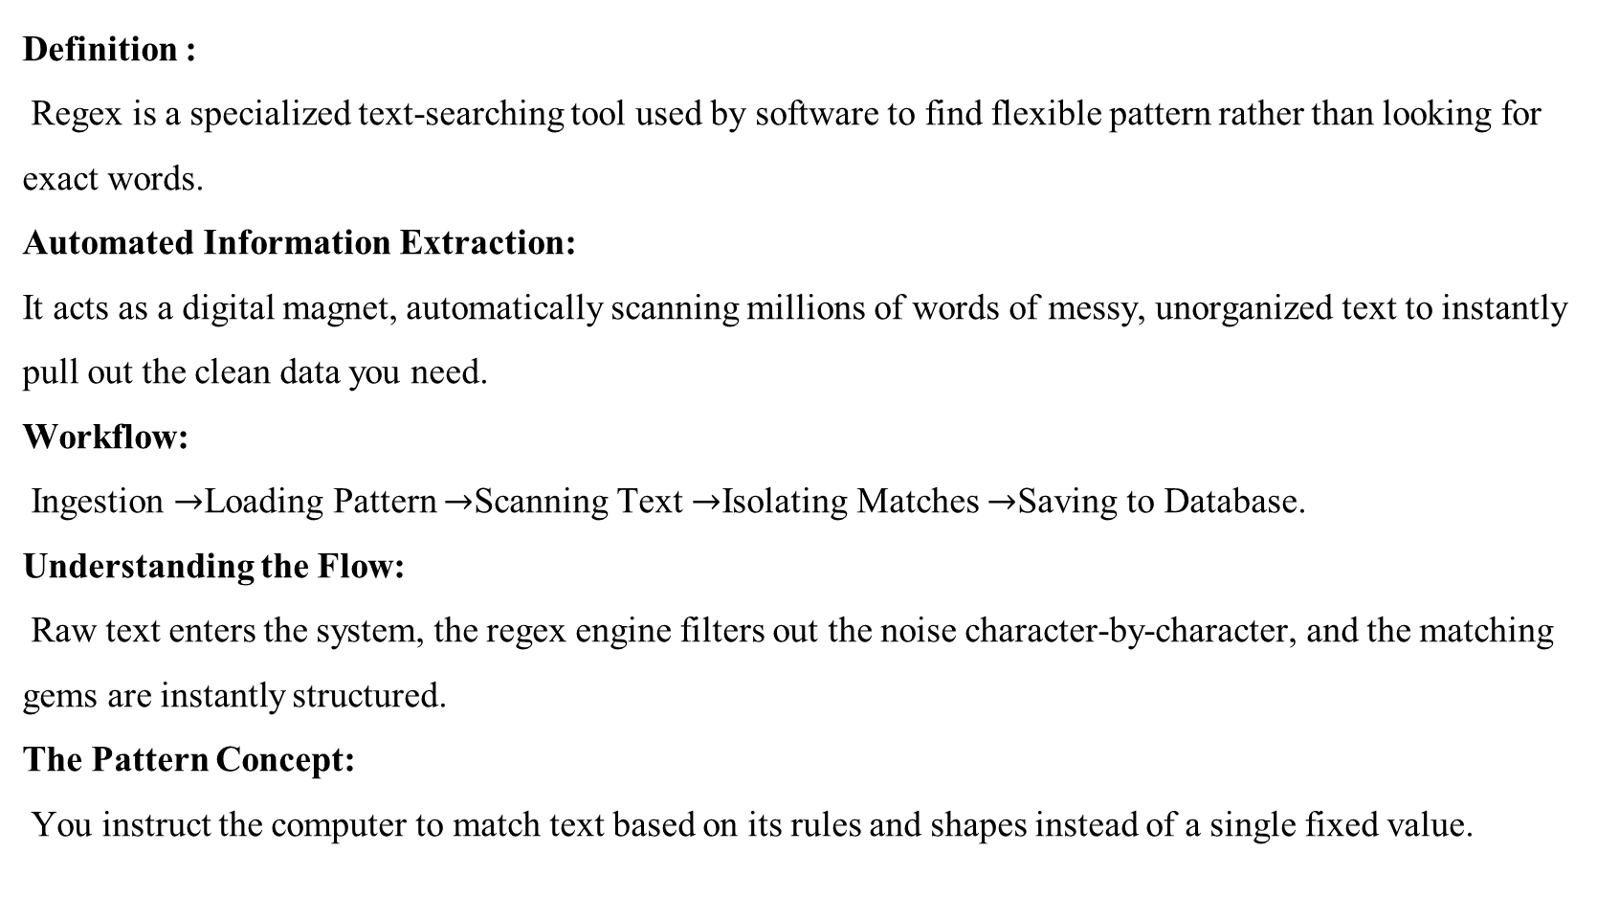
INTRODUCTION
Definition :
Regex is a specialized text-searching tool used by software to find flexible pattern rather than looking for exact words.
Automated Information Extraction:
It acts as a digital magnet, automatically scanning millions of words of messy, unorganized text to instantly pull out the clean data you need.
Workflow:
Ingestion $→$Loading Pattern $→$Scanning Text $→$Isolating Matches $→$Saving to Database.
Understanding the Flow:
Raw text enters the system, the regex engine filters out the noise character-by-character, and the matching gems are instantly structured.
The Pattern Concept:
You instruct the computer to match text based on its rules and shapes instead of a single fixed value.

Slide 3
HOW IT WORKS
Step 1:
Reading the Blueprint :The regex engine loads your specific pattern rules into the computer's memory, setting up the exact character roadmap it needs to follow.
Step 2:
Character-by-Character Scanning: The engine begins crawling through the raw text file, checking it one single letter, number, or symbol at a time from left to right.
Step 3:
Evaluating Structural Matches :As it scans, the engine tests the text against your blueprint rules, verifying sequences like "three numbers followed by a dash."
Step 4:
Filtering and Skipping Noise: If the text does not fit the structural rules, the engine instantly discards it, skipping over regular paragraphs to find data gems.
Step 5:
Extracting and Exporting :Once a complete match is found, the engine isolates those specific characters, pulls them out of the text, and routes them to a database

Slide 4
REAL –WORLD EXAMPLES
Data Type | Extracted Value | Status
Primary Email | contact@company.com | Verified & Clean
Secondary Email | billing-support@net.org | Verified & Clean
Deadline Date | 2026-07-15 | Validated Format
Phone Number | (555) 019-2834 | Standardized

Slide 5
REAL –WORLD EXAMPLES
Extracting Email Addresses: The pattern automatically grabs text surrounding the @ symbol while successfully ignoring punctuation marks at the end of sentences.
Unifying Phone Numbers: The blueprint captures contact numbers uniformly, even if people wrote them using spaces, dashes, parentheses, or country codes.
Isolating Website URLs: The system instantly copies complex web links out of paragraphs without accidentally cutting off long tracking codes.
Standardizing Calendar Dates: The engine recognizes global date variations (like day-first vs month-first) while automatically blocking fake dates like a 45th day.
Targeting Tracking IDs: The pattern pulls out fixed-length codes, such as package shipping serial numbers, credit cards, or customer order IDs.

Slide 6
METHODS USED
Setting Strict Boundaries: Developers use special "anchor" markers to tell the engine exactly where to look, skipping millions of unnecessary characters.
Using Specific Character Rules: We eliminate guesswork by forcing the computer to look only for numbers or only for letters in exact positions.
Applying Non-Capturing Groups: This advanced trick lets the system group text for checks without wasting computer memory on data we do not need.
Enforcing Safety Timeouts: Adding a tight time limit forces the system to safely give up on confusing text instead of freezing the software.
Pre-Compiling the Logic: Saving the pattern rule into the computer's memory first saves massive amounts of repetitive hardware processing power.
.

Slide 7
FUTURE SCOPE
Solving the Data Flood: This topic was chosen because manually sorting through thousands of messy emails and business files is too slow and expensive.
Preventing System Crashes: Designing patterns efficiently is mandatory to stop bad data or typos from overloading the computer's processor and freezing applications.
The High-Speed AI Pre-Filter: In the future, lightning-fast regex patterns will serve as a cheap filter to clean raw text before it hits expensive AI models.
Rigid Guardrails for AI Verification: Text patterns will be heavily used to double-check AI answers, ensuring the system catches fake or hallucinated data instantly.
The Hybrid Engineering Era: The ultimate future of software engineering lies in combining the absolute, rule-based speed of Regex with the human-like understanding of AI.
.

